Slide 1
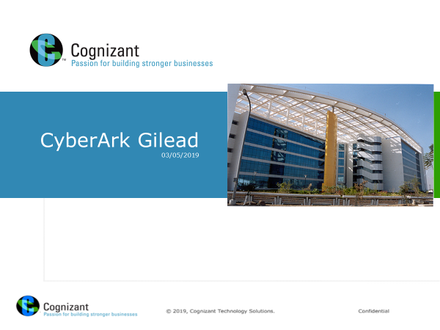
Cyber-Ark PIM
Training- Lab Guide
Mahesh Gaikwad

Slide 2
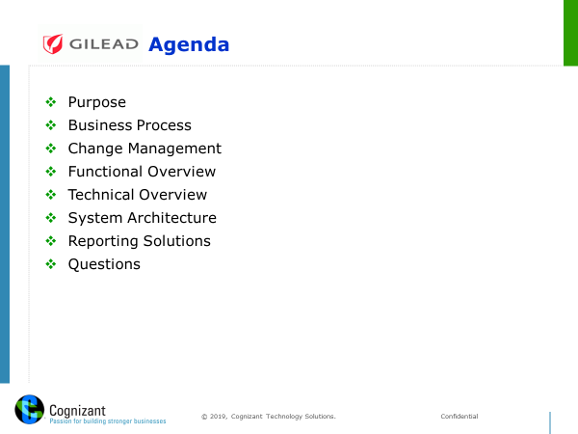

Slide 3

The Risk
The problem created by privileged accounts:
! Most powerful accounts in the Gilead
! Access sensitive information
! Rarely changed, known to many
! No individual user accountability
ADM Accounts
Service Accounts
Application Accounts

Slide 4
GPV Major Components in Gilead
Enterprise Password Vault (EPV)
Central Policy Manager (CPM)
Password Vault Web Access (PVWA)
Privileged Session Manager (PSM)

Slide 5
Cyber-Ark PIM major components
Enterprise Password Vault (EPV)
Central Policy Manager (CPM)
Password Vault Web Access (PVWA)
Privileged Session Manager (PSM)

Slide 6
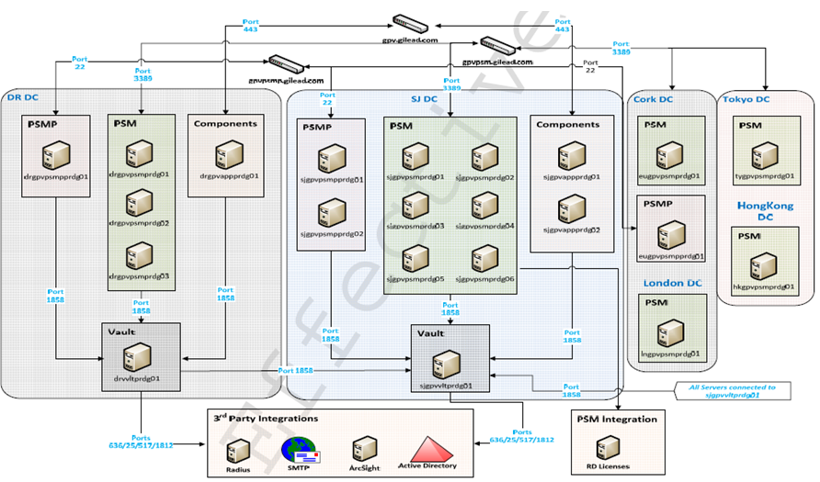
Enterprise Password Vault in Gilead

Slide 7
Cyber-Ark PIM major components in Gilead
Enterprise Password Vault (EPV)
Central Policy Manager (CPM)
Password Vault Web Access (PVWA)
Privileged Session Manager (PSM)

Slide 8
Cyber-Ark PIM major components
Enterprise Password Vault (EPV)
Central Policy Manager (CPM)
Password Vault Web Access (PVWA)
Privileged Session Manager (PSM)

Slide 9


CPM in Gilead
System | User | Pass
Unix A | root
Unix B | root
Unix C | root
Oracle A | SYS
Oracle B | SYS
tops3cr3t
tops3cr3t
password1
tops3cr3t
psw4adm
tops3cr3t
orac1e
orac1e
T&y3p0L
Qom$3#a
O8=p<zZ
mN85p:a
nc7Sd3R
l+zM6t1
j7t5QdC
T&y3p0L
Qom$3#a
O8=p<zZ
mN85p:a
nc7Sd3R
l+zM6t1
j7t5QdC
P9i$b%
P9i$b%
Log5%t
Log5%t
gvIna9%
gvIna9%
o70X#jJ
o70X#jJ
R73#m-
R73#m-
yOb2@1
yOb2@1
x8wF$2
x8wF$2
O9^aziA
O9^aziA
Iu~1@r
Iu~1@r
cqg8@fz
cqg8@fz
0in7$&x
lm7yT5w
lm7yT5w
0in7$&x
iaX3f#!
iaX3f#!
iIt$8sa
iIt$8sa
orac1e
Servers
O8=p<zZ
O8=p<zZ
Personal ID
System | User | Pass
Oracle A | TEST
Oracle A | PPRD
Oracle A | QUAL
Oracle A | CONV
Oracle A | TRNG
Oracle A | PROD
password1
Central Policy Manager
password2
Vault
IT personnel
password3
password4
password5
Central Policy Manager
Change Passwords
Verify Passwords
Reconcile Passwords
password6
Databases
System | User | Pass
Desktop A | Administrator
Desktop B | Administrator
Laptop C | Administrator
psw4adm
psw4adm
psw4adm
PCs

Slide 10
Cyber-Ark PIM major components
Enterprise Password Vault (EPV)
Central Policy Manager (CPM)
Password Vault Web Access (PVWA)
Privileged Session Manager (PSM)

Slide 11
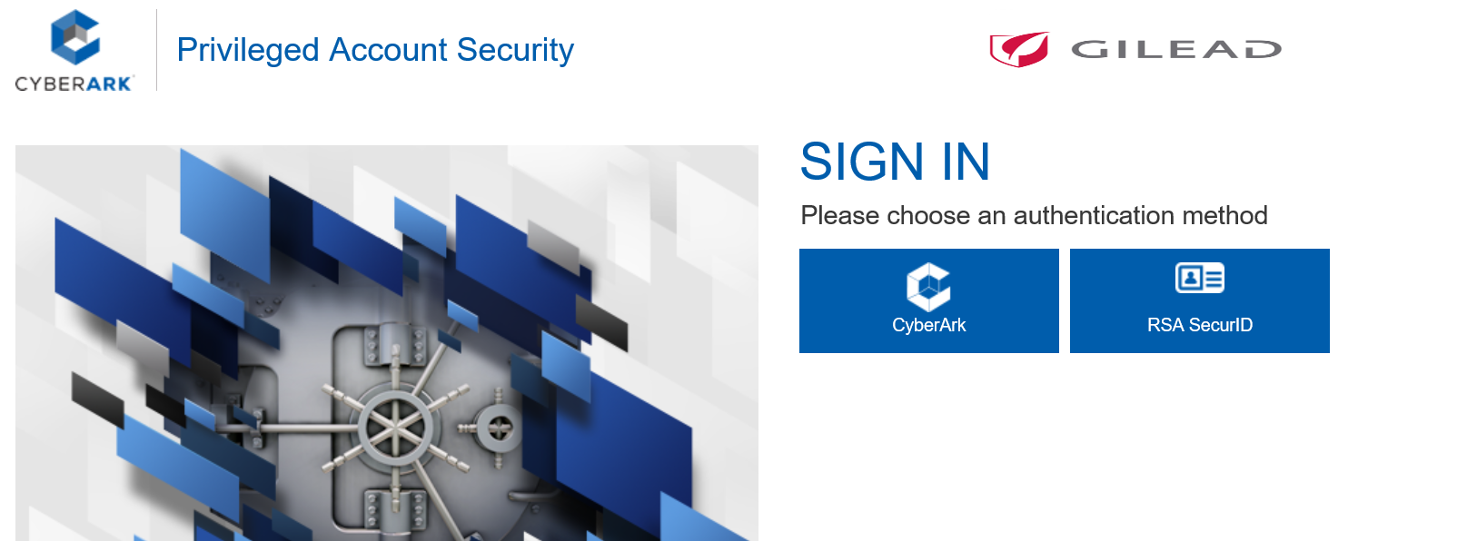
PVWA

Slide 14
Cyber-Ark PIM major components
Enterprise Password Vault (EPV)
Central Policy Manager (CPM)
Password Vault Web Access (PVWA)
Privileged Session Manager (PSM)

Slide 15
PSM in Gilead

Slide 16
Privileged Session Manager (PSM)

